Slide 1
WHOSE JACKET IS THIS?
ANGLICKÝ JAZYK – 9. ROČNÍK
Mgr. Daniela Vallušová

Slide 2
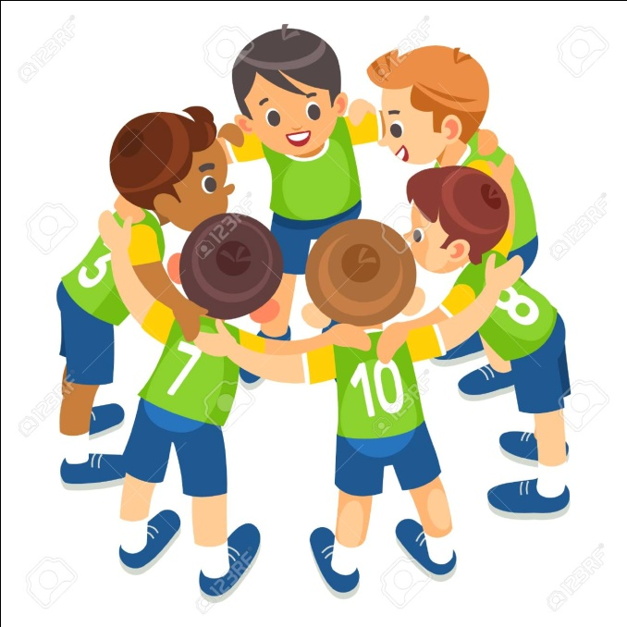
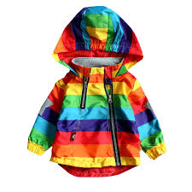
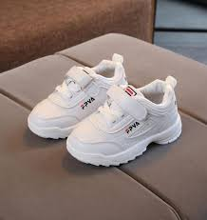
VOCABULARY – SLOVNÍČEK
team - tím
jacket- bunda
trainers - tenisky
https://www.youtube.com/watch?v=1uiaMsTnys8

Slide 3
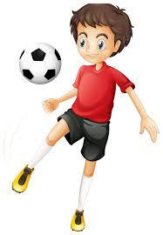
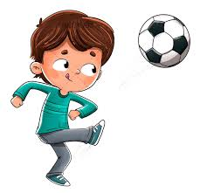
VOCABULARY – SLOVNÍČEK
trophy - trofej
player - hráč
kick - kopnúť
https://www.youtube.com/watch?v=1uiaMsTnys8

Slide 4
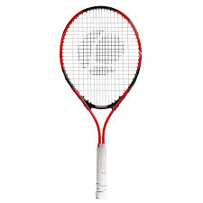
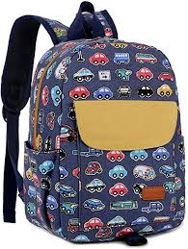
VOCABULARY – SLOVNÍČEK
score a goal – dať gól
racket – raketa
rucksack – batoh
win – vyhrať
https://www.youtube.com/watch?v=1uiaMsTnys8

Slide 5
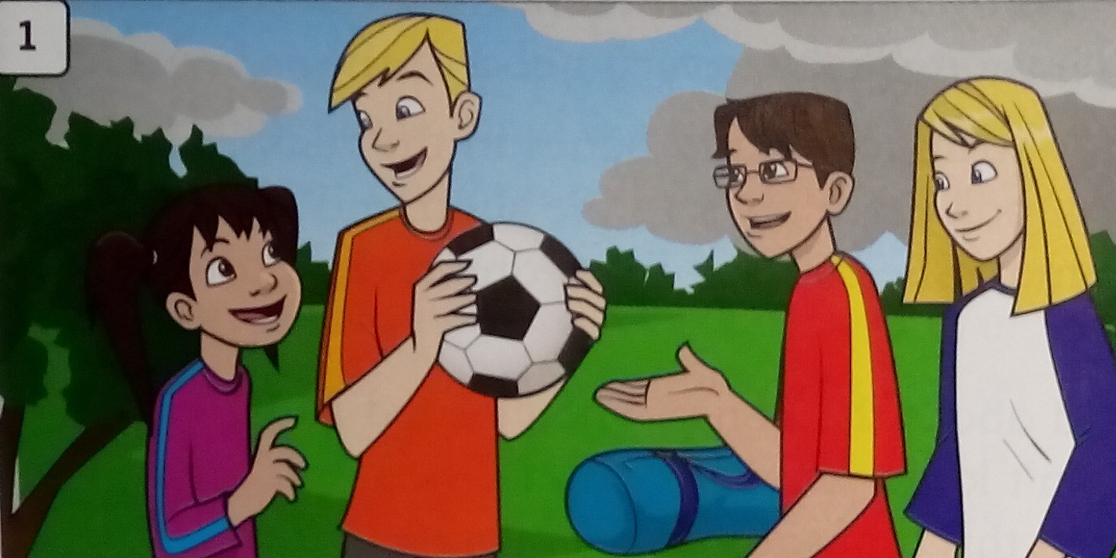
LISTEN AND READ
Leo: Come on. Let´s play football!
Max: Great! Let´s have two teams.
Leo and Amy against Holly and me.
https://www.youtube.com/watch?v=1uiaMsTnys8

Slide 6
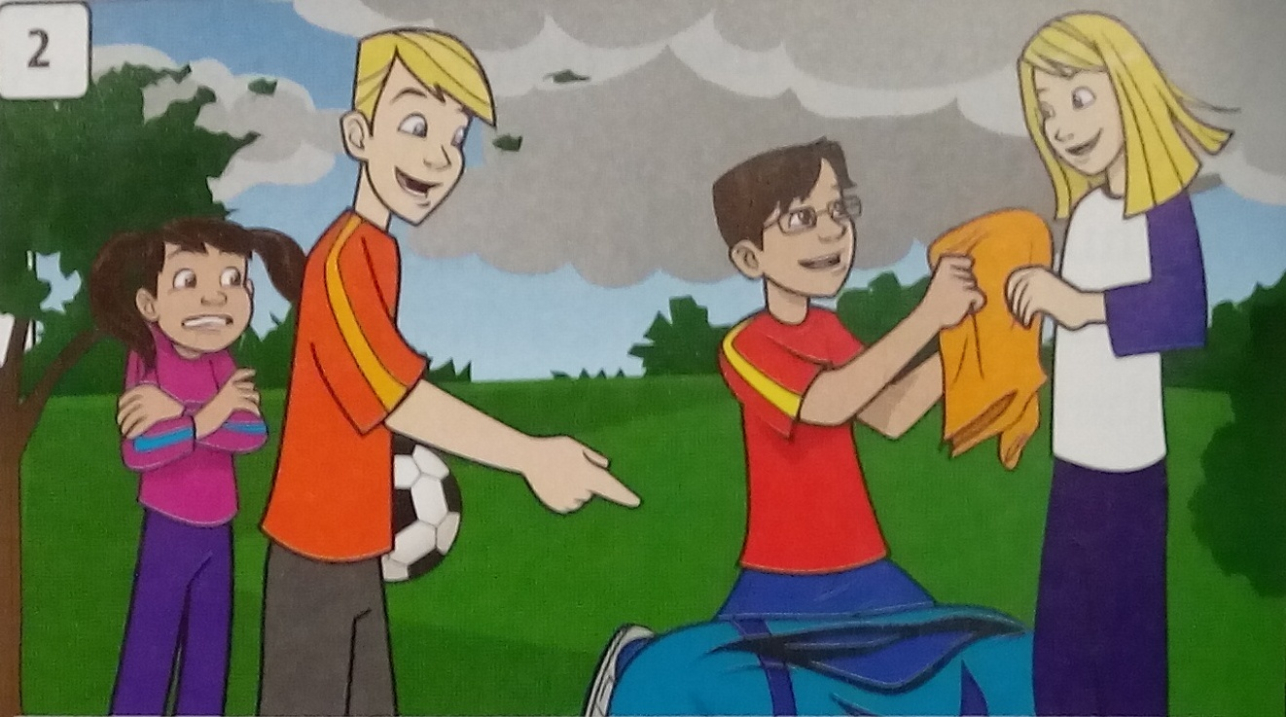
Leo: It´s cold now.
Let´s put on our jackets.
Max: Whose jacket is this?
Is it yours, Amy?
Amy: Yes, it´s mine. Thanks.
https://www.youtube.com/watch?v=1uiaMsTnys8

Slide 7
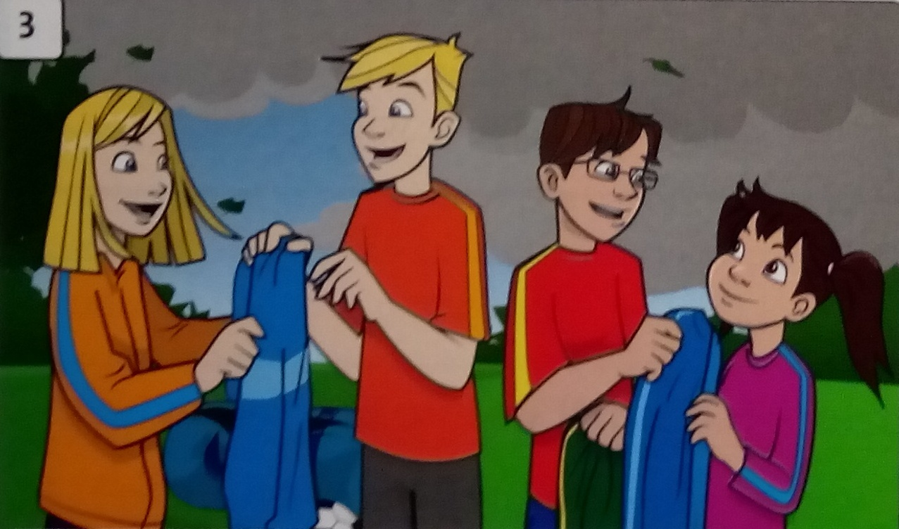
Amy: Is this one yours, Leo?
It´s blue.
Leo: Yes, my jacket´s blue.
Max: This one is mine.
And this blue jacket is hers.
Here you are, Holly.
https://www.youtube.com/watch?v=1uiaMsTnys8

Slide 8
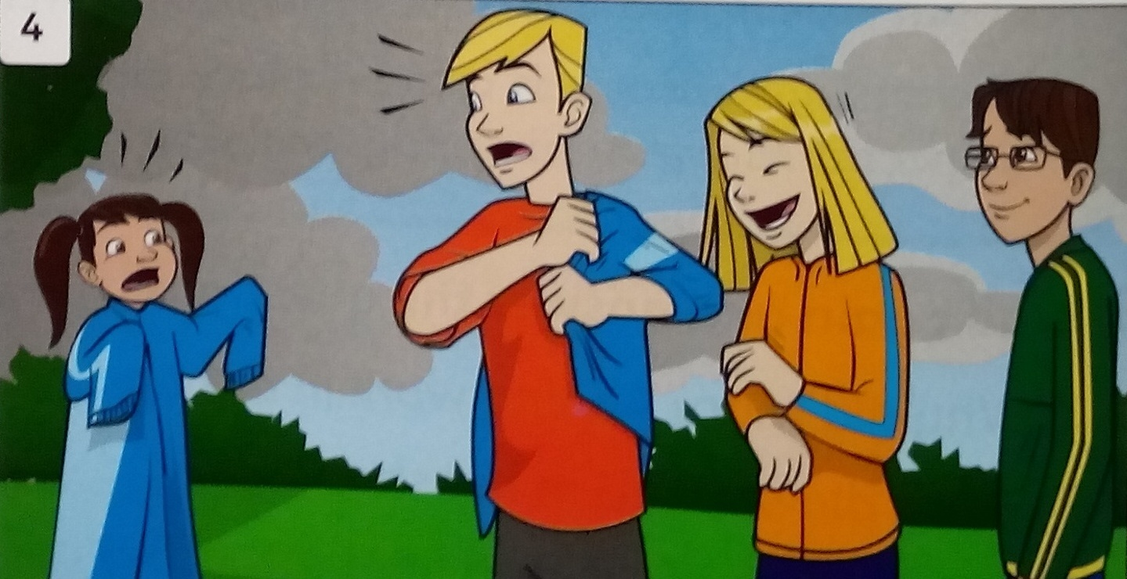
Holly: That jacket is very small, Leo.
Are you sure it´s yours?
And mine is really big.
Leo: Oh no!
I´ve got yours.
That´s why it´s so small for me!
https://www.youtube.com/watch?v=1uiaMsTnys8

